Slide 1
False belief, false photo and modularity

Slide 2
Stimulus Array?
The stimulus array is the set of environmental features that could be the basis of association between stimulus and response
So Stimulus -Response learning is associating a feature of the stimulus array with the right response

Slide 3
Stimulus Array is Observable
Features of the stimulus array are perceived /observed

Slide 4
Hidden Causes
The explanation of the properties of the stimulus array is an inference about hidden causes
Forces and fields are hidden causes
E.g. an object falls because of gravitational force. Magnetic fields attract or repel.
We don’t see or touch gravity or magnestism: we infer their nature from observational evidence

Slide 5
Hidden Causes
Inferring hidden causes is ubiquitous
it is what the mind does
Species, race, physical properties like charge, polarity, momentum, mass velocity
When the mind encounters a pattern it unifies and explains the pattern by categorising the entities in terms of shared essential properties

Slide 6
Hidden Causes
Inferring hidden causes is ubiquitous
OFTEN the mind is wrong! E.g. “race” is not a casually efficacious entity
Physicists biologists and chemists are constantly refining their explanations
“Mass” means different things for Newton and Einstein
Dark Matter? Gravity waves?

Slide 7
Behaviourism Again
Behaviourism allows that perception is representational (we see a world of objects and properties)
But we don’t need to explain intelligent behaviour by postulating representation of underlying causes
Subjects associate features of the stimulus array with the adaptive behavioural response

Slide 8
DEEP REPRESENTATIONALISM
DETECTS AND REPRESENTS CAUSAL STRUCTURE THAT PRODUCES PATTERNS OF FEATURES
INTERNAL MODELS abstract representation of causal structure
Causal Structure
Stimulus Array
Response
Pattern

Slide 9
DEEP REPRESENTATIONALISM of OTHER MINDS
DETECTS AND REPRESENTS CAUSAL STRUCTURE THAT PRODUCES PATTERNS OF FEATURES
INTERNAL MODELS abstract representation of causal structure OTHER’ S MIND
Response
Pattern Attribute Other’s Mental State
Causal Structure other’s
Mental state
Stimulus Array Overt Behavior PLUS featuresof environment

Slide 10
Minds are hidden causes
Other people’s minds are hidden causes of their behaviour
So explaining other people in terms of their hopes, fears, beliefs, feelings, jealousies, generosities etc etc
Are all inferences about hidden causes

Slide 11
Folk Psychology and Propositional Attitudes
I believe it is warm in Phuket
I hope it is warm in Phuket
I want it to be warm in Phuket
I’m afraid it is warm in Phuket
Different attitudes (psychological states) same proposition

Slide 12
Folk Psychology
We explain intelligent behaviour by attributing attitudes to the subject
Suggesting that the PAs cause the behaviour.
In some sense this is so obvious that it is hardly a deep theory of human behavior
I believe it is hot in Phuket and I desire to go on holiday somewhere warm so I go to Phuket
I believe it is raining in Phuket and I want to go on holiday somewhere dry so I don’t go to Phuket

Slide 13
Folk Psychology
Makes people practically rational: their attitudes doxastic (belief) and motivational (desire) explain their actions
Theoretically rational
Their beliefs fit together holistically according to rules of inference
Called procedural rationality. i.e. procedures for constructing a consistent set of beliefs

Slide 14
DEEP REPRESENTATIONALISM of OTHER MINDS
DETECTS AND REPRESENTS CAUSAL STRUCTURE THAT PRODUCES PATTERNS OF FEATURES
INTERNAL MODELS abstract representation of causal structure OTHER’ S MIND
Response
Pattern Attribute Other’s Mental State BELIEFS DESIRES
That rationalise behaviour
Causal Structure other’s
Mental state
Stimulus Pattern Overt Behavior

Slide 15
Heider Simmel
Ubiquitous and automatic
https://www.youtube.com/watch?v=8FIEZXMUM2I&ab_channel=drwilliamashton

Slide 16
MINDREADING
Quite general term referring to
The ability to detect and respond appropriately to other’s mental states
In this general sense is very inclusive
Sharing emotions (contagion) empathy
Social referencing, joint attention
Explicit verbal understanding
Underwrites almost all forms of social cognition

Slide 17
MINDREADING and METAREPRESENTATION
I believe that S (mental state) … p
I believe that you (believe, desire, hope…)
My mental state represents your mental state. It is a metarepresentation of the relationship between your mind and a proposition
Or your mind’s representation of the causal structure of the world

Slide 18
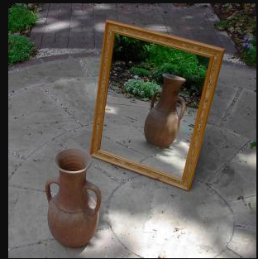
METAREPRESENTATIONAL EMBEDDING

Slide 19
Metarepresentational Embedding
The picture represents the representational relationship between the representation (mirror) and its object (vase)
Can do it with sentences, formulae
AND MENTAL STATES
She sees that he sees that he sees …
I believe that you hope that she wants that he believes…

Slide 20
THEORY OF MIND
Specific ability tested by the false belief task (see video here https://www.youtube.com/watch?v=RibbgbQ6wbk)
The task is to understand that someone who sees an object in location A, but is not present when an object is moved to location B will look to the previous location (A)
3 year olds cannot do this
5 year olds do
Notes:
.

Slide 21
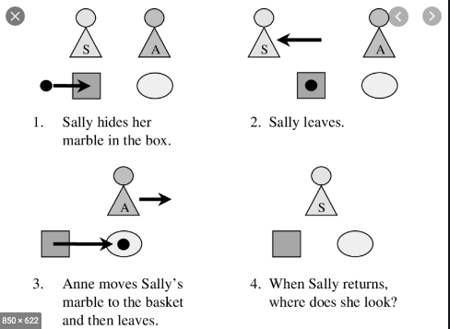

Slide 22
THEORY OF MIND (2)
WHAT HAPPENS ?
THEORY OF MIND INTERPRETATION
THE 5 YEAR OLD IS ABLE TO FORM A BELIEF ABOUT ANOTHER PERSON’S BELIEFS
IT’S A SPECIALISED FORM OF METAREPRESENTATION
A Belief about belief
Subject Believes That (Other Person Believes …

Slide 23
Child as Scientist
The child is a “little scientist” forming hypotheses about other people’s mind
By about 5 they come up with the hypothesis that other people act on the basis of their beliefs which can be false
FB test dramatises this because it falsifies a previous belief about location of object, but the person acts on the basis of the false belief

Slide 24
Domain-General Metarepresentation
BY the time the child is 5 she has a general capacity for metarepresentation
Which she applies to other people’s beliefs
To form beliefs about other people’s beliefs
In other words false belief test is part of general reasoning ability

Slide 25
MODULAR THEORY OF MIND
FALSE BELIEF TEST IS AN INSTANCE OF MATURATION OF A MODULE
Specialised cognitive system for metarepresenting mental states

Slide 26
Why believe in Modular view?
Seems to develop independently of capacity for metarepresentation
Different neural substrates
Downs children and 3-4 y.o. pass the FB test but are not good at metarerpesentational tasks in general
Autism. Problems with false belief even when good at other forms of metarepresentation

Slide 27
False Photo Test
Same structure as FB but subject watches while experimenter uses a polaroid camera to take a photo of object
While photo is being developed the object is moved
The question is “WHERE IS THE object IN THE PHOTO”

Slide 28
False Photo
3 year olds pass false photo!! FAIL FALSE BELIEF
Autistic children pass false photo FAIL FALSE BELIEF
DOUBLE DISSOCIATION

Slide 29
VIDEOS (in one place)
https://www.youtube.com/watch?v=RUpxZksAMPw
https://www.youtube.com/watch?v=jbL34F81Rz0

Slide 30
To read
http://bostonreview.net/books-ideas/rebecca-saxe-reading-your-mind
Also the article by Virginia Slaughter in the course folder.

Slide 31
Is there a behaviourist interpretation?
i.e. child is associating a feature of the stimulus array with the looking behaviour? What feature? Gaze?
This becomes very important when we look at animal
More next week. But in the meantime watch this https://www.youtube.com/watch?v=wItHza3m364

Slide 32
Is there a domain general interpretation
A very complex issue!
Consider this
Is reading a modular ability?
Is language?
Is passing the FB test more like aquiring the ability to read or more like acquiring a language?

